Slide 1
PHMS
Orientation
Prepared by:
C. Flint

Slide 2
Agenda
General Information
Rituals and Routines
Borrowing Library Books
Lexile Score
Book Recommendations
1st Day of Checkout
Devices
Questions

Slide 3
General Information
Media Specialist (Librarian)
Ms. Flint
Hours of Operation (Students)
8:45 AM - 4:00 PM daily

Slide 4
General Information
No food or drinks are allowed in the media center.
Keep the media center clean and neat.
Students are to push their chair under the table or computer workstation when they get up.

Slide 5
General Information
Students are allowed to visit the media center with their class.
Teachers will use the sign-up sheets on the school’s website to schedule class visits.
Students are also allowed to visit the media center individually or in small groups (no more than 4) to checkout library books, read, study, research, etc.

Slide 6
General Information
If students visit the media center individually or in a small group, they must have a hall pass from their teacher.
A note from the teacher indicating the purpose of the visit and length of time students are to stay in the media center must be provided as well.

Slide 7
Rituals and Routines
Students are to enter the media center quietly and use their indoor voice during their entire visit.

Slide 8
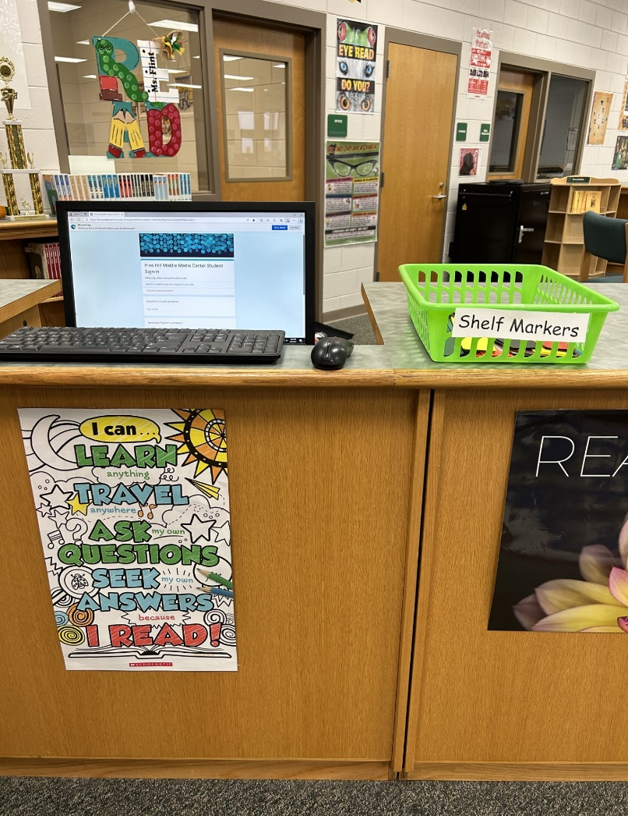
Rituals and Routines
Students will use the computer at the circulation desk to sign in.

Slide 9
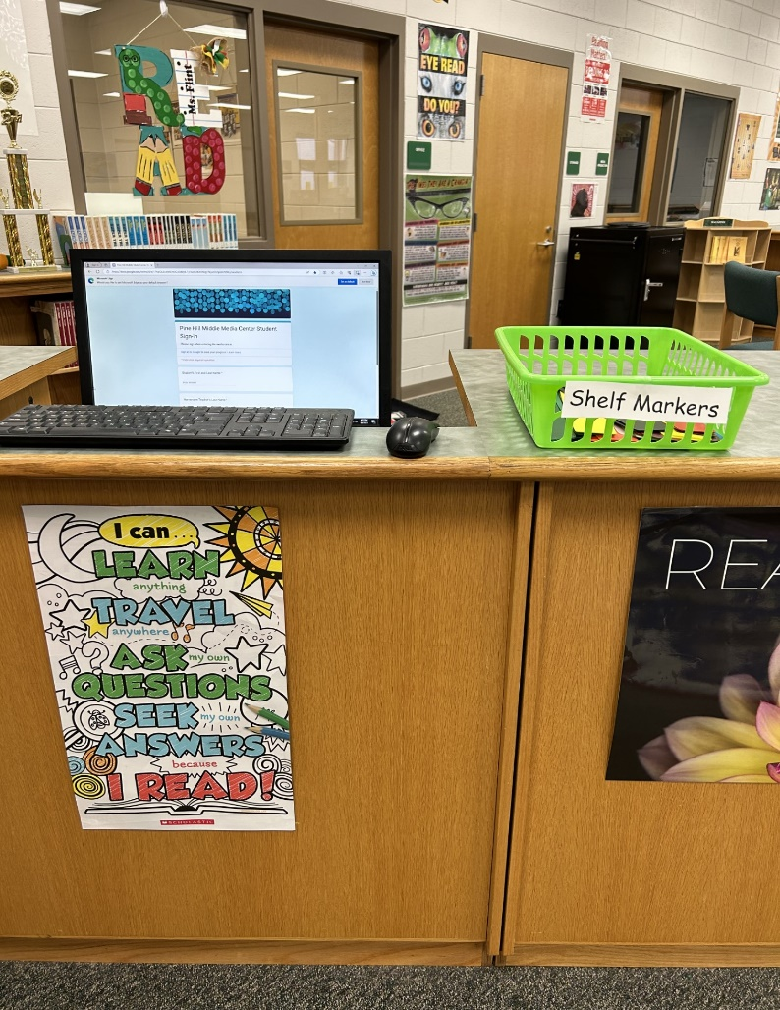
Rituals and Routines
After students sign in, they are to obtain a shelf marker.

Slide 10
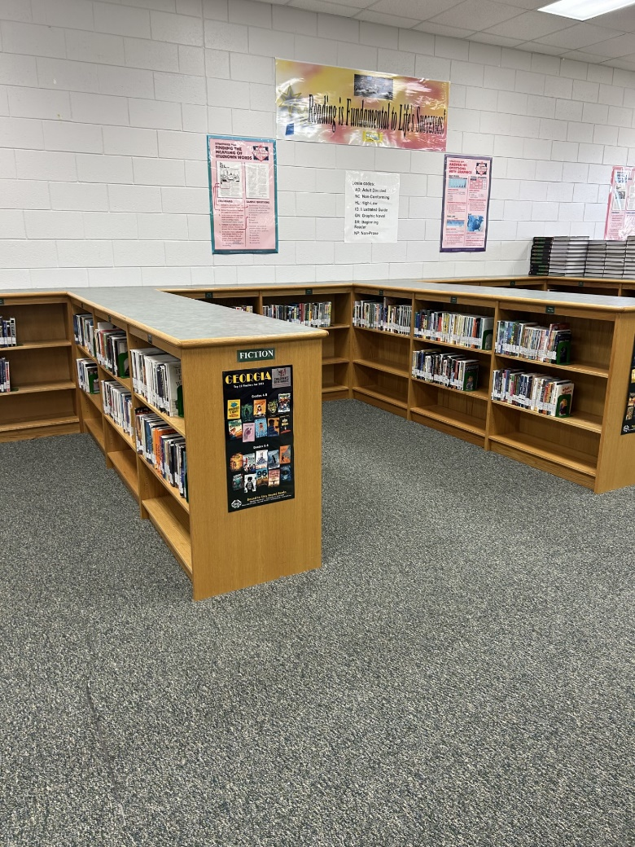
Rituals and Routines
Students will use the steps in the following video to help them effectively utilize shelf markers so that the books in our media center remain in order.

Slide 11
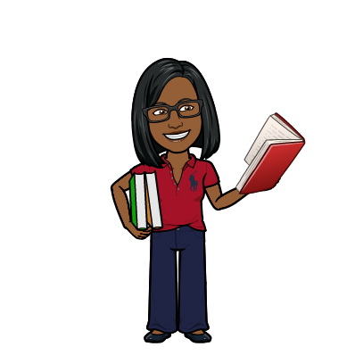
Borrowing Library Books from the Media Center
Students may checkout two library books at a time.
Students may checkout library books for two weeks.
Students are responsible for the library books that they checkout.

Slide 12
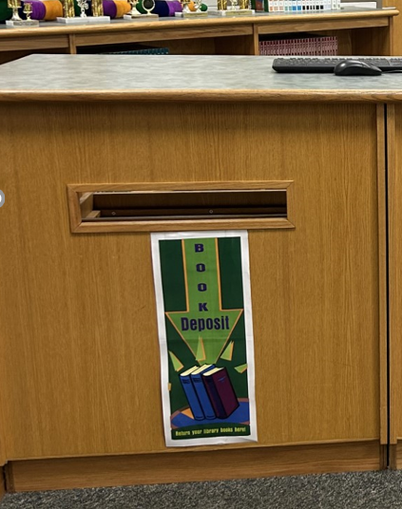
Borrowing Library Books from the Media Center
When students return their library book to the media center, they are expected to place their library books in the book drop.

Slide 13
Borrowing Library Books from the Media Center
Checkout/Overdue notices will be sent out at the end of each grading period.
Late fees are not charged
Students must pay for lost or damaged books

Slide 14
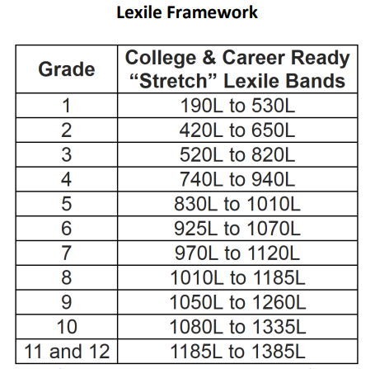
Lexile Score
It is imperative that students obtain their current Lexile Score (Reading Level) from their teacher.

Slide 15
Lexile Score
Students can checkout books 100L below their Lexile Score and 50L above their Lexile Score.
Example
If a student’s Lexile Score is 950L, the student’s Lexile range is 850L to 1000L.

Slide 16
Book Recommendations
What titles would you like to see in Pine Hill Middle School’s Collection?
Example: Diary of a Wimpy Kid NO BRAINER

Slide 17
Book Recommendations
Students can follow the instructions below to make book recommendations:
Log on to the Internet
Go to the school’s website
www.rcboe.org/pinehill
Select Staff & Departments
Choose Media Center
Click on the tab labeled Library Book Recommendation Form

Slide 18
1st Day of Checkout
Monday, September 18, 2023

Slide 19
Devices
Day-users are not allowed to take their device home. Devices must be returned to the homeroom teacher’s cart at the end of the school day.
Take-home users are take their device home and bring their device to school each day.
Devices that need servicing, must be brought to the media center no later than 10:00.

